Slide 1



Forest Fire Detection Using Deep learning
Name : Chandu Pateti
AICTE Student ID: STU676e3dc28c3b71735278018
AICTE Internship ID: INTERNSHIP_173855432067a03bd0ddfb6

Slide 2

Learning Objectives
➤ Understand Deep Learning I want to explore how deep learning mimics the brain to help machines recognize image patterns and learn like humans.
➤ Learn to Use Datasets I aim to gain skills in downloading, cleaning, and preparing datasets for model training, ensuring my data is structured and model-ready.
➤ Build a CNN Model I want to create my own Convolutional Neural Network (CNN) using TensorFlow and Keras to analyze and learn from image data.
➤ Train and Test Models I want to learn how to train CNNs using real image data and evaluate them with test sets. I’ll explore epochs, validation, and strategies to improve model accuracy.
➤ Measure Performance I want to understand and interpret key evaluation metrics like accuracy and loss to track my model's performance and identify areas for improvement.
➤ Visualize the Results I aim to use Matplotlib to create plots showing training accuracy and loss over time, helping me visualize how my model is learning.
➤ Make Predictions on New Images I want to apply my trained model to new, unseen data and understand how to interpret the prediction results with confidence.
➤ Apply to a Real-World Problem As a final objective, I want to apply everything I’ve learned to a real-world project—such as detecting forest fires with deep learning—to demonstrate practical impact and build a strong portfolio piece.
GOAL

Slide 3
Tools and Technology used
Google Colab
A cloud-based platform that allows me to write and execute Python code in a Jupyter notebook environment. It provides free access to GPUs, which speeds up the training of deep learning models.
Jupyter Notebook
An interactive web application that enables me to create and share documents containing live code, equations, visualizations, and narrative text. It is useful for documenting the process and results of my project.
Python
The programming language used for writing the code. It is widely used in data science and machine learning due to its simplicity and readability.
TensorFlow
An open-source deep learning framework that provides tools for building and training machine learning models. It is used to create the Convolutional Neural Network (CNN) for fire detection.
Keras
A high-level API for TensorFlow that simplifies the process of building and training deep learning models. It is used to define the architecture of the CNN.
NumPy
A library for numerical computing in Python. It is used for handling arrays and performing mathematical operations on data.
Matplotlib
A plotting library for Python that is used to create visualizations of the model's training progress, such as accuracy and loss graphs.
ImageDataGenerator
A Keras utility that helps in preprocessing images for training, validation, and testing. It allows for real-time data augmentation to improve model performance.
Github repository link: https://github.com/Sunny-commit/wildfire_detection_internship.git

Slide 4
Methodology
Dataset Acquisition
Downloaded the wildfire dataset from Kaggle using Google Colab.
Data Exploration
Explored the dataset to identify classes ('fire' and 'nofire') and visualized sample images.
Data Preparation
Set image size to 150x150 pixels and batch size to 32.
Used ImageDataGenerator to rescale images and create data generators for training, validation, and testing.
Model Building
Built a Convolutional Neural Network (CNN) with Keras:
Added convolutional and MaxPooling layers for feature extraction.
Flattened the data and added dense layers for classification.
Model Compilation
Compiled the model using the Adam optimizer and binary cross-entropy loss.
Model Training
Trained the model for 12 epochs, monitoring accuracy and loss.
Model Evaluation
Evaluated the model on test data and visualized training results.
Making Predictions
Saved the model and created a function to predict fire in new images.

Slide 5
Problem Statement:
The primary objective of this project is to develop a deep learning model capable of accurately detecting forest fires from images. Forest fires pose a major environmental threat, leading to the destruction of ecosystems, loss of wildlife, and risks to human life and property. Early detection is crucial to mitigate these impacts and enable timely response.
To address this challenge, I will utilize a dataset containing images of both fire-affected and unaffected areas. My approach involves training a Convolutional Neural Network (CNN), a powerful deep learning model well-suited for image recognition tasks. The CNN will be trained to identify key visual indicators of fire—such as smoke, flames, and color variations—allowing it to distinguish between hazardous and safe regions.
Accurate classification of these images can facilitate real-time alerts for firefighters and emergency responders, helping them take swift action to contain fires before they spread. This can ultimately save lives, protect wildlife, and conserve natural resources.
Beyond addressing a critical environmental issue, this project will deepen my understanding of deep learning techniques, including data preprocessing, model training, and evaluation. Ultimately, I aim to contribute a practical solution for forest fire detection while highlighting the role of AI in environmental protection

Slide 6
Solution:
Use a Dataset:
I will work with a dataset that has images of both burning and non-burning areas.
Prepare the Data:
The images will be resized to 150x150 pixels and normalized to make them easier for the model to learn from.
Build the Model:
I will design a CNN with:
Convolutional Layers to find important features in the images.
MaxPooling Layers to simplify the data.
Dense Layers to classify the images as 'fire' or 'no fire'.
Train the Model:
The model will be trained on the dataset, learning to recognize patterns that indicate fire.
Evaluate Performance:
I will test the model on new images to see how accurately it can detect fires.
Make Predictions:
I will create a function that allows users to upload images and get predictions on whether they show fire.

Slide 7
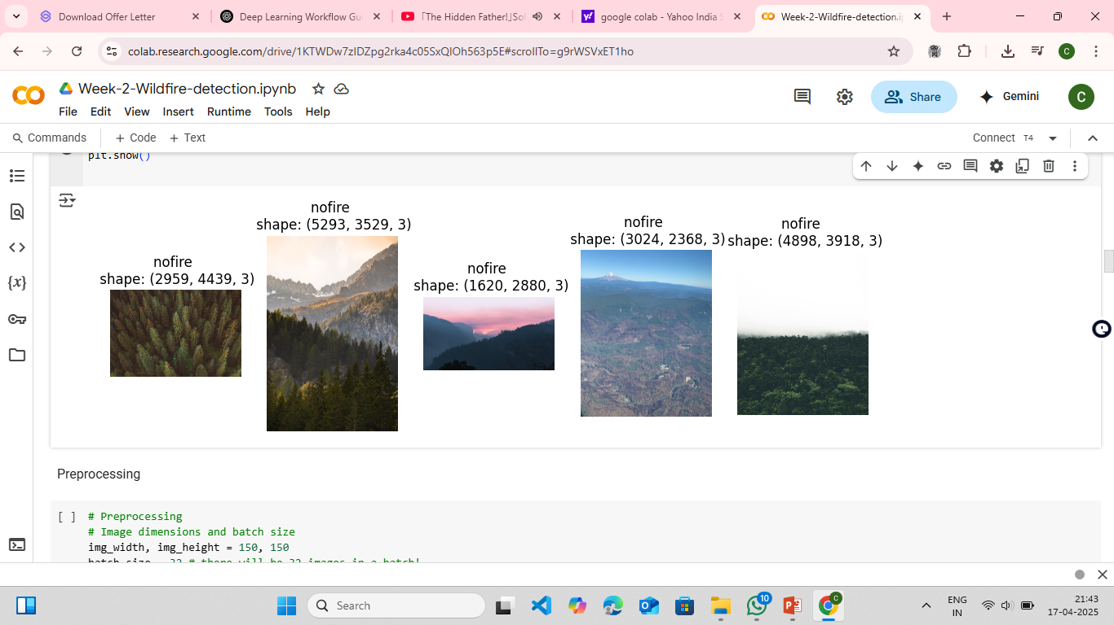
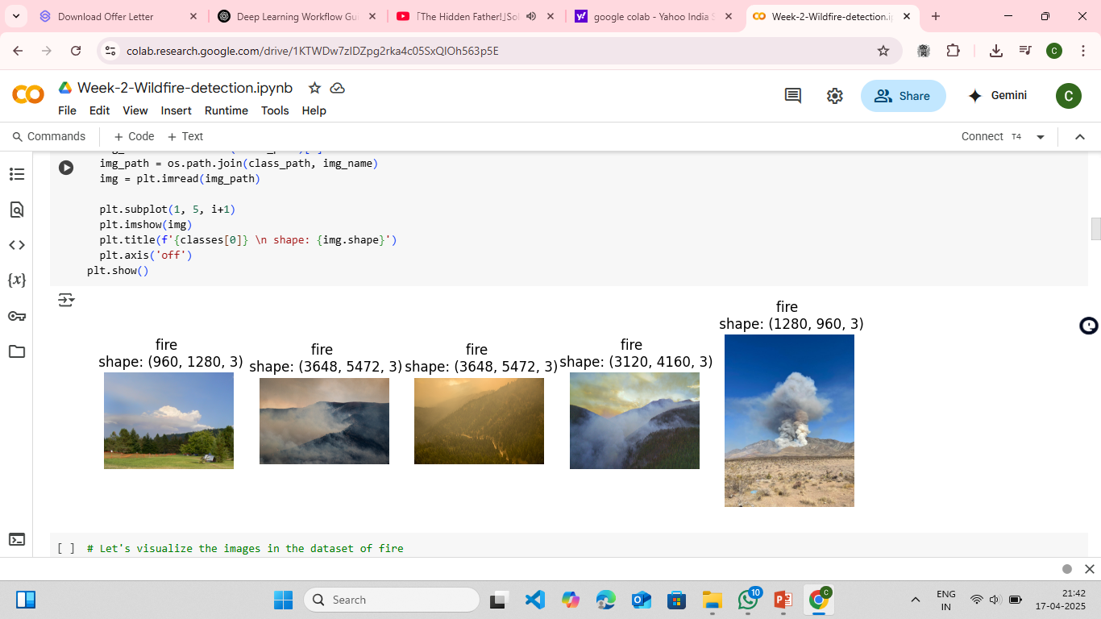
Screenshot of Output of fire and no fire:

Slide 8
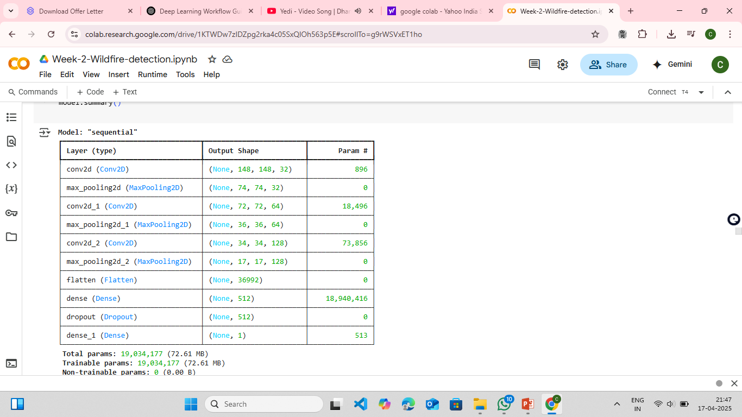
Screenshot of Output of Model: "sequential":

Slide 9
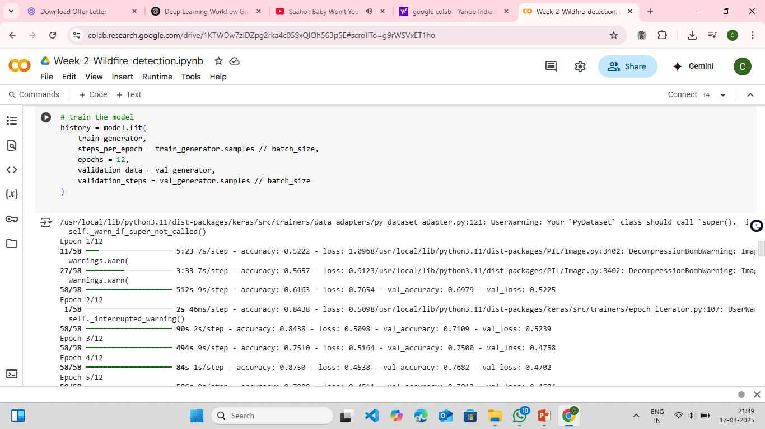
Screenshot of Output of training the model:

Slide 10
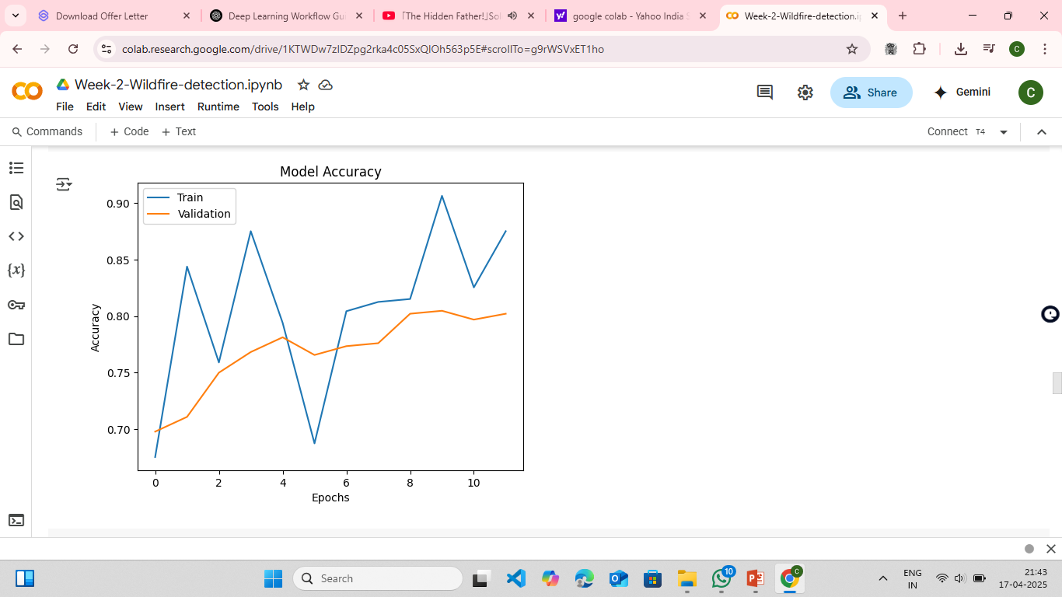
Screenshot of Output of model accuracy :

Slide 11
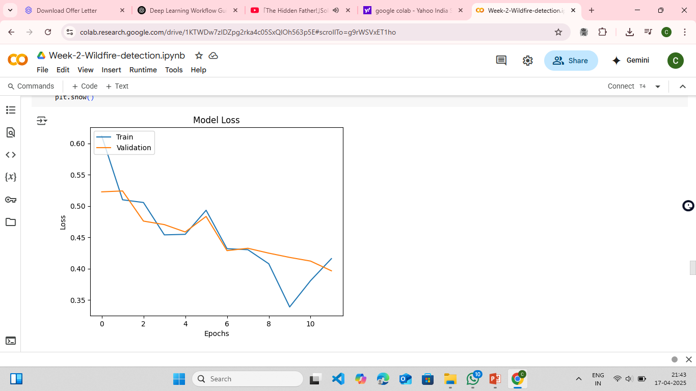
Screenshot of Output of model loss :

Slide 12
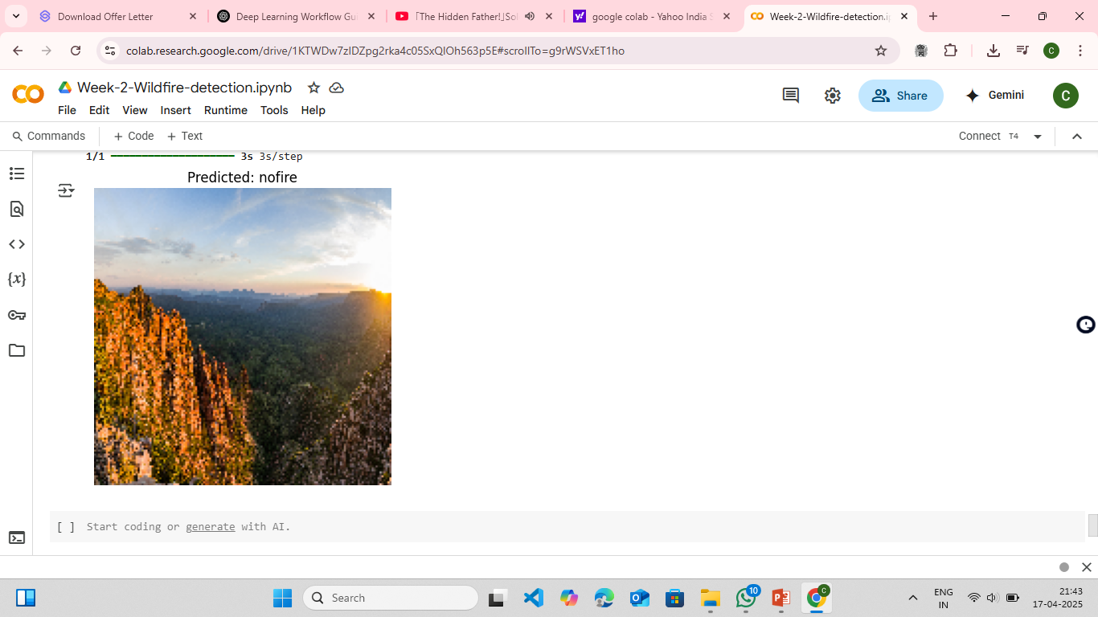
Screenshot of Output of predicted :

Slide 13
Conclusion:
Project Summary: Forest Fire Detection Using Deep Learning
In this project, I successfully developed a deep learning model to detect forest fires using a Convolutional Neural Network (CNN). The journey began with collecting and preparing a dataset consisting of images with and without fire. By training the model on this data, I was able to teach it how to differentiate between these two types of images.
Key Achievements:
The model showed high accuracy in identifying fire-affected areas.
It demonstrated strong potential for early fire detection, which is crucial for preventing the spread of wildfires.
Such timely detection can support faster emergency responses, protecting forests, wildlife, and communities.
Skills Gained:
Data preprocessing and image handling techniques.
Building, training, and evaluating CNN models using TensorFlow/Keras.
Interpreting key performance metrics like accuracy, precision, recall, and loss.
Understanding how AI can be used to address real-world challenges.
Looking Ahead:
I plan to further improve the model by:
Introducing a larger and more diverse dataset.
Experimenting with different CNN architectures.
Applying the model in real-world fire management systems.
This project significantly enhanced my understanding of deep learning and its impact on solving environmental problems. It also reinforced the importance of using technology to protect natural ecosystems. I am motivated to continue building solutions like this that can contribute meaningfully to environmental protection.

Slide 14
Future Scope:
Model Improvement:
I want to enhance the accuracy of the model by experimenting with different architectures and techniques. This could involve using more advanced CNN structures or incorporating other machine learning methods to improve performance.
Larger Datasets:
Using a larger and more diverse dataset can help the model learn better. I plan to gather more images from various environments and conditions, which will make the model more robust and capable of detecting fires in different scenarios.
Real-Time Detection:
I aim to develop a system that can analyze images in real-time, such as from drones or satellite imagery. This would allow for immediate alerts when a fire is detected, enabling quicker responses from firefighting teams.
Integration with Other Technologies:
I want to explore how this model can be integrated with other technologies, like geographic information systems (GIS) or weather data. Combining these tools could provide a more comprehensive approach to fire management and prevention.
Field Testing:
Conducting field tests to see how the model performs in real-world situations is crucial. I hope to collaborate with fire management agencies to implement the model in actual fire detection scenarios and gather feedback for further improvements.
Public Awareness and Education:
I believe it’s important to raise awareness about the role of technology in fire detection. I plan to share my findings and insights with the community, emphasizing how early detection can help protect our environment and lives.

